Slide 1

WELCOME

Slide 2

Amrutvahini College of Engineering, Sangamner.
A PROJECT REPORT ON : Home Air Quality Monitoring System
PRESENTED BY :
Mr. Ambhure Vaishnav Shivaji (03)
Mr. Bhadke Shubham Vilas (08)
Mr. Gawali Akshay Bhanudas (19)
SUBMITTED TO :
Dr. R.S. Pawase

Slide 3
INDEX
INTRODUCTION
BASIC BLOCK DIAGRAM & CIRCUIT DIAGRAM
COMPONENTS
SIMULATION
WORKING
CONCLUSION
REFERENCES

Slide 4
INTRODUCTION
To measure the air quality in the apartment, this air quality monitoring system can be used. This air quality detector not only measures the Carbon Dioxide (CO2) level in the air, but also measures the level of humidity and temperature both inside the room and outside environment. This project consists of two sensors namely, temperature cum humidity sensor and CO2 sensor. These sensors are attached with the system inside the room to calculate the room temperature, humidity and CO2 and also on the roof of the house to calculate the atmosphere temperature, humidity and CO2. It also has LCD attached to it which displays the value of the temperature, humidity and CO2 levels measured.

Slide 5
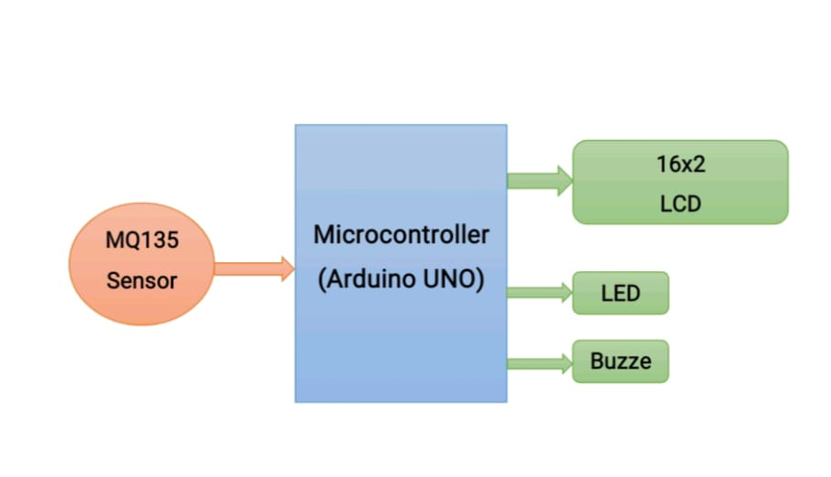
Block Diagram

Slide 6
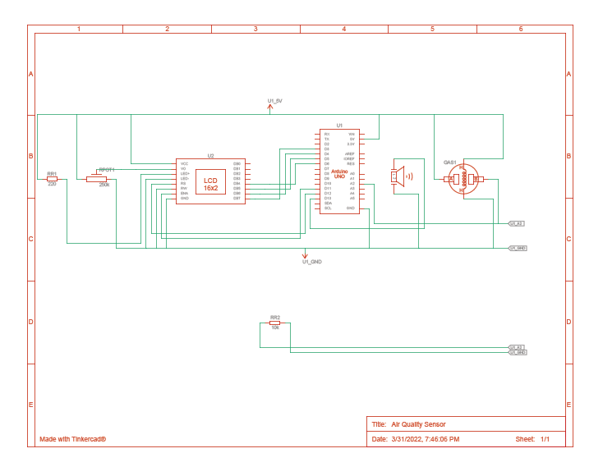
Circuit Diagram

Slide 7
COMPONENTS
MQ 135 Sensor
Arduino UNO
Breadboard
Buzzer
Jumper Wires Pack
LED
16x2 LCD Display

Slide 8
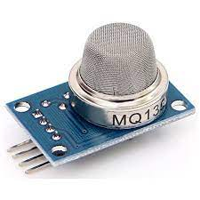
MQ 135 Sensor
The MQ-135 Gas sensor can detect gases like Ammonia (NH3), sulfur (S),
Benzene (C6H6), CO2, and other harmful gases and smoke.
Similar to other MQ series gas sensor, this sensor also has a digital and analog output pin.
When the level of these gases go beyond a threshold limit in the air the digital pin goes high.

Slide 9
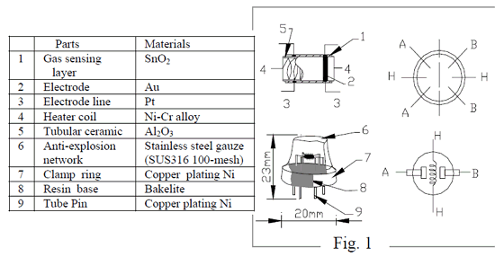
Datasheet MQ 135 Sensor

Slide 10
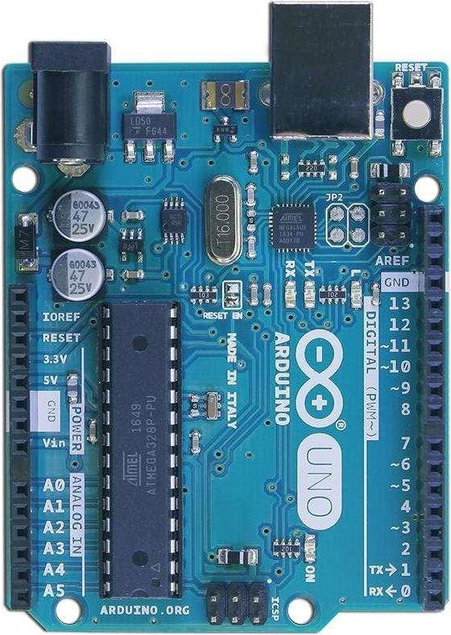
Arduino UNO
The UNO is the most used and documented board of the whole Arduino & Genuino family.
Arduino UNO is a microcontroller board based on the ATmega328P(datasheet).
14 Digital I/O pins
6 Provides PWM outputs
6 Analog Inputs pins
16 MHz frequency(clock speed)
32KB flash memory

Slide 11
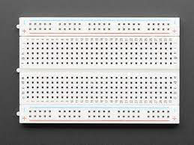
Breadboard
A breadboard, or protoboard, is a construction base for prototyping of electronics.
Originally the word referred to a literal bread board, a polished piece of wood used when slicing bread.
In the 1970s the solderless breadboard (a.k.a. plugboard, a terminal array board)
became available and nowadays the term "breadboard" is commonly used to refer to these.

Slide 12
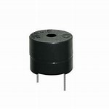
Buzzer
Sound Type: Continuous Beep
Rated Voltage: 6V DC
Resonant Frequency: ~2300 Hz
Operating Voltage: 4-8V DC
Rated current: <30mA
Small and neat sealed package
Breadboard and Perf board friendly

Slide 13
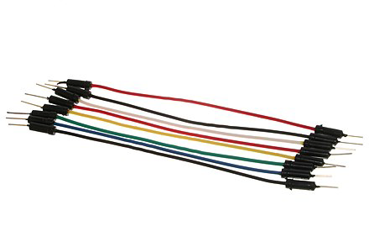
Jumper Wires
A jump wire (also known as jumper, jumper wire, DuPont wire) is an electrical wire, or group of them in a cable, with a connector or pin at each end (or sometimes without them – simply "tinned"), which is normally used to interconnect the components of a breadboard or other prototype or test circuit, internally or with other equipment or components, without soldering.

Slide 14
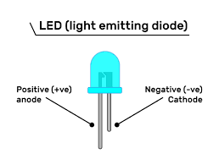
LED (Light Emitting Diode)
A light-emitting diode (LED) is a two-lead semiconductor light source. It is a p–n junction diode that emits light when activated. When a suitable voltage is applied to the leads, electrons are able to recombine with electron holes within the device, releasing energy in the form of photons.
Made popular by their efficiency, range of color, and long lifespan, LED lights are ideal for numerous applications including night lighting, art lighting, and outdoor lighting.
These lights are also commonly used in electronics and automotive industries, and with many other uses.

Slide 15
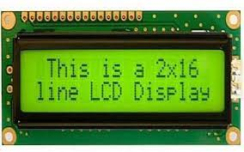
16x2 LCD Display
A 16x2 LCD means it can display 16 characters per line and there are 2 such lines.
In this LCD each character is displayed in 5x7 pixel matrix.
The 16 x 2 intelligent alphanumeric dot matrix display is capable of displaying 224 different characters and symbols.
This LCD has two registers, namely, Command and Data.

Slide 16
16x2 LCD Datasheet
Pin No: | Pin Name: | Description
1 | Vss (Ground) | Ground pin connected to system ground
2 | Vdd (+5 Volt) | Powers the LCD with +5V (4.7V – 5.3V)
3 | VE (Contrast V) | Decides the contrast level of display. Grounded to get maximum contrast.
4 | Register Select | Connected to Microcontroller to shift between command/data register
5 | Read/Write | Used to read or write data. Normally grounded to write data to LCD
6 | Enable | Connected to Microcontroller Pin and toggled between 1 and 0 for data acknowledgement
7 | Data Pin 0 | Data pins 0 to 7 forms a 8-bit data line. They can be connected to Microcontroller to send 8-bit data. These LCD’s can also operate on 4-bit mode in such case Data pin 4,5,6 and 7 will be left free.
8 | Data Pin 1
9 | Data Pin 2
10 | Data Pin 3
11 | Data Pin 4
12 | Data Pin 5
13 | Data Pin 6
14 | Data Pin 7
15 | LED Positive | Backlight LED pin positive terminal
16 | LED Negative | Backlight LED pin negative terminal

Slide 17
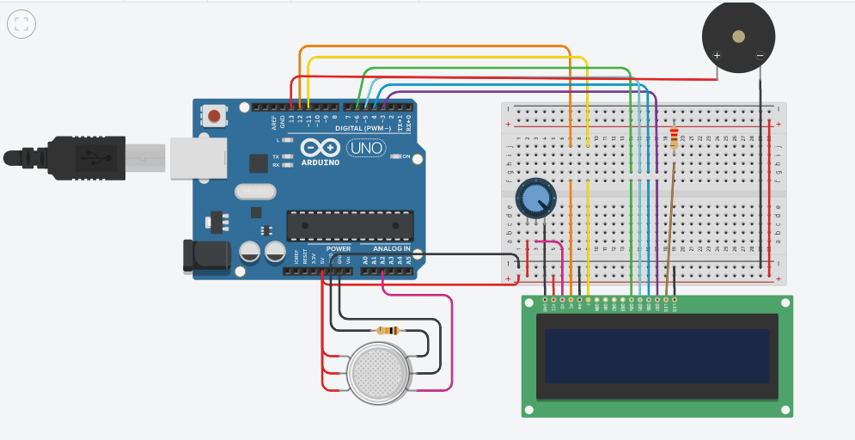
Simulation
https://www.tinkercad.com/things/7WkbAitHP8k-air-quality-sensor/editel?sharecode=sSYXuV03l8IeWVRyuDt1560x3FabSju7hyxhv8FOtd8

Slide 18
Working
Connections:
DTH11’s voltage, ground is connected to +5V and 0V and signal can be connected to any Digital Pin 8 of Arduino Uno.
MQ135’s voltage and ground are connected to +5V and 0V and analog output pin is connected to analog Pin A0 of Arduino Uno.
LCD RS pin to digital pin 12, Enable pin to digital pin 11,D4 pin to digital pin 5, D5 pin to digital pin 4, D6 pin to digital pin 3, D7 pin to digital pin 2, R/W pin to ground, VSS pin to ground, VCC pin to 5V, 10K resistor ends to +5V and ground and wiper to LCD VO pin.
The data pins of DHT11 are connected to Digital pin of Node MCU and that of MQ135 is connected to Analog Pin.
The other connections are kept the same.

Slide 19
Conclusion
This system is used to send gas like benzene, alcohol, smoke, etc. using the MQ135 Gas Sensor.
To monitor the air of the environment using an Arduino microcontroller, IOT Technology is proposed to improve the quality of air. The use of Io technology enhances the process of monitoring various aspects of the environment such as the air quality monitoring issue proposed in this paper.
The system This board has a Wi-Fi module that acts as the internet connector and informative access for the air quality. This measures the air quality in real-time using MQ135 Gas Sensor with Node MCU.
Node MCU will send the data to things peak platform which is connected with Twitter, so whenever the air quality goes below a certain level it will send the Twitter notification, thus warning people in that particular area.
Here the use of the MQ135 gas sensor gives the sense of the different types of dangerous gas and Arduino is the heart of this project which controls the entire process.
Wi-Fi module connects the whole process to the internet and LCD is used for the visual Output It supports the new technology and effectively supports the healthy life concept. This system has features for people to monitor the amount of pollution on their mobile phones using the application.

Slide 20
Reference
https://en.wikipedia.org/wiki/Arduino#/media/File:UnoConnections.jpg
http://www.circuitbasics.com/how-to-set-up-the-dht11-humidity-sensor-on-an-arduino/
https://www.robot-r-us.com/vmchk/sensor-temp/humid/dht11-temperature-and- humiditysensor.html
https://electrosome.com/power-supply-design-5v-7805-voltage-regulator/
youtube
www.google.com

Slide 21
THANK YOU …

